Slide 1

Prepared by:-
1)Bhavsar Shruti Rajesh-(2202031030006)
2)Singh Gunjan Rajesh-(2202031030128)
3)Chauhan Hiren YogeshBhai-(2202031030009)
Guide Name:-
Prof. Yogeshwari mam
Title Of Project:-
Salon management system

Slide 2
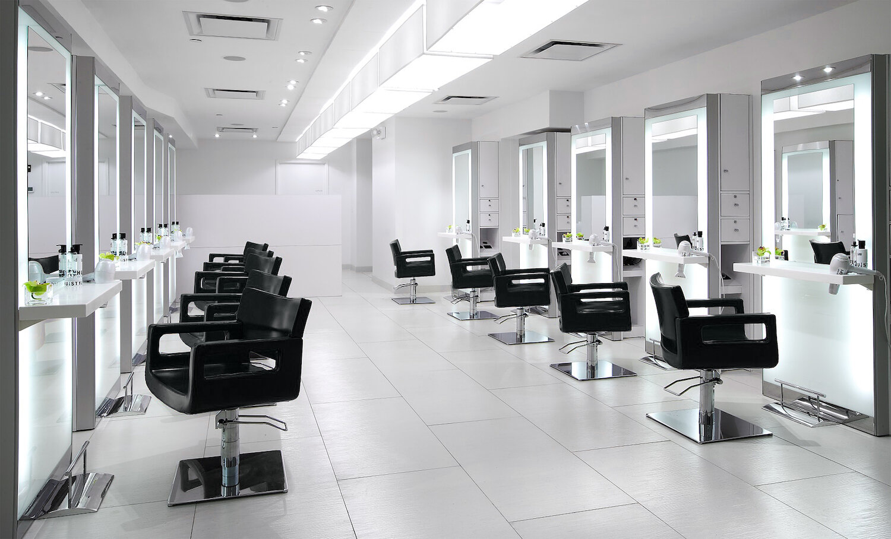
Saloon Management System

Slide 3
Index
1 Introduction
2 Problem Definition (Abstract)
3 Modules
4 Functional Requirement

Slide 4
Introduction of system
When customers search the salon then the system will show all the available salons on their locations and if by chance the time you have searched is not available then it will also show the next vacant slots on our system which is registered with our platform on that location.
After booking their appointment in the saloon there is no need to stand in the queue just reach there in the allotted time and students will get the service without any delay or waiting in the saloon

Slide 5
Problem definition-Abstract
As the technology advances these days it is very important to have a Hair salon Management System especially for functionality Services like Appointment booking , Staff management etc. to ensure that everything runs smoothly and that the operation won’t be compromised but optimized so, the owners can gain more profit.
Having a Hair salon Management System it simplifies Hair salon operations management that increases your salon’s efficiency and make your customers satisfied.

Slide 6
Module
Admin
Admin decides what is to be done & when it is to be done.
Admin is a thinking function because plans & policies are determined under it.
Basic function of an admin:-planning, organizing, staffing,coordinating, reporting and budgeting.

Slide 7
Functional Requirement of admin
Log-in
Admin can login into system using this feature.
Admin will enter username and password for log-in.

Slide 8
Functional Requirement of admin
Manage users
Admin are responsible for setting up user accounts and user identifiers (UIDs).
Admin ensure that all users have the appropriate access to the files, systems and applications they need.

Slide 9
Functional Requirement of admin
Add shop details
The main objective of an admin is to Manage the details of Stock, Payments, Sales, Discounts,Products.
It manages all the information about Stock, Inventory, Products, Stock.
Admin keep tracks of goods from the point of purchase through production and sales to the point of sale.

Slide 10
Functional Requirement of admin
View monthly sales
Admin can view information on sales volume, leads, new accounts, revenue and costs for a given period.
Admin also view sales funnel which provides a clear view of the opportunities available to a sales team, accurately showing the revenue the team is going to make in the months ...

Slide 11
Module
User
User is an organizational function that enables users to access and control digital assets such as:-
Applications
Devices
Networks
cloud services.

Slide 12
Functional Requirement for user
Log-in
User can login into system using this feature.
User will enter username and password for log-in into the application.

Slide 13
Functional Requirement for admin
Schedule/Book appointment
User can book or access the online appointment management system via the URL provided by the saloon itself or through a “Book Now” button in the website.
In system user can choose Date and Time from the slots which are available.
Once the time and date are selected, the system confirms the bookings automatically and also records it within the system instantly without any intervention from the staff.

Slide 14
Functional Requirement for admin
View services
User can view the available services provided by the saloon.
User can choose the services based on its requirement.

Slide 15
Functional Requirement for admin
Give reviews
User can give reviews and feedback which will directly reflect to the admin panel.
User reviews can help in evaluate management system performance, the need for change and improvement, and the suitability of business policies and objectives

Slide 16
Database tables
Table: user_master
Primary key: u_id
Table: shop_master
Primary key: s_name
Field Name | Datatype(Size) | Constraint | Description
u_id | int | Primary Key, Auto-Increment | ID of User
u_name | varchar(30) | not null | Name of User
email | varchar(50) | not null | Email of user
gender | varchar(6) | not null | Gender of user
birth_date | date | not null | Birth Date
u_phone | int(10) | not null | Phone Number
u_pic | blob | not null | Profile Picture of User
u_type | int(1) | not null | Type of the user (1-Admin,2-Shop owner,3-user)
username | varchar(20) | not null | Username of the user
password | varchar(20) | not null | Password of the user
city_id | int | foreign key | Foreign key references city_master
Field Name | Datatype(Size) | Constraint | Description
s_name | int | Primary Key, Auto- Increment | Name of shop
s_address | varchar(150) | not null | Shop address
pincode | Int(6) | not null | Shop pincode
bank_id | Int(11) | not null | Bank id
city | Varchar(11) | not null | City of an shop
b_name | Varchar(30) | not null | Bank name
ac.no | Int(15) | not null | User account number
Ifsc_code | Varchar(15) | not null | Ifsc code
Acc_type | varchar(7) | not null | Account type
Acc_holder_name | varchar(30) | not null | Name of an account holder
S_feedback | Varchar(150) | Not null | Feedbacke

Slide 17
Database tables
Table: membership_table
Primary key: m_id
Table: product_table
Primary key: p_id
Field Name | Datatype(Size) | Constraint | Description
m_id | Int | Primary Key, Auto Increment | ID of membership
m_name | varchar(40) | Not null | Name of Membership
m_price | int(11) | Not null | Prices of membership
m_desc | varchar(100) | Not null | Description About membership
m-duration | datetime | Not null | Time Duration of membership
m_discount | int(11) | Not null | discounts
m_cashback | int(11) | Not null | Cashback on discount
m_offer | varchar(100) | Not null | Offers on Membership
Field Name | Datatype(Size) | Constraint | Description
p_id | int(11) | Primary Key, Auto Increment | ID of product
p_name | varchar(40) | Not null | Name of product
p_com | varchar(40) | Not null | Company of product
p_price | int(10000) | Not null | Price of product
Image | blob | Not null | Product image
p_details | varchar(100) | Not null | Details about the product
quantity | int(3) | Not null | product quantity

Slide 18
Database tables
Table: appointment_master
Primary key: ap_id
Table: offer_table
Primary key: off_id
Table: service_master
Primary key: ser_id
Field Name | Datatype(Size) | Constraint | Description
ap_id | int(11) | Primary Key, Auto-Increment | ID of City
ap_time | varchar(100) | Not null | Name of city
ap_service | varchar(500) | Not null | services
u_id | int(11) | Not null | User id
e_id | int(11) | Not null | Employee id
Field Name | Datatype(Size) | Constraint | Description
off_id | Int(11) | Primary Key, Auto Increment | ID of offer
off_name | varchar(40) | Not null | Name of offer
off_terms | varchar(100) | Not null | Terms and conditions for the offer
off-duration | datetime | Not null | Time Duration of offer
off_discount | int(11) | Not null | Discounts in offer
Field Name | Datatype(Size) | Constraint | Description
ser_id | int | Primary Key, Auto Increment | ID of service
ser_name | int | Not null | Name of an service
ser_price | int | Not null | Services prices
ser_app_time | int | Not null | Appointment time an service

Slide 19
Database tables
Table: employee_master
Primary key: e_id
Table: feedback_table
Primary key: f_id
Table: invoice_master
Primary key: b_no
Field Name | Datatype(Size) | Constraint | Description
e_id | int(11) | Primary Key, Auto Increment | Employee id
u_id | int(11) | Not null, foreign key | User id
reviews | int(15) | not null | Review of employee
ap_id | varchar(150) | Not null, foreign key | Appointment id
Field Name | Datatype(Size) | Constraint | Description
f_id | int(11) | Primary Key, Auto Increment | Feedback id
f_desc | int(11) | Not null | Feedback description
u_id | int(11) | Foreign key | User id
e_id | int(11) | Foreign key | Employee id
Field Name | Datatype(Size) | Constraint | Description
e_id | int | Primary Key, Auto Increment | ID of shop
s_id | int | Foreign key | Id of City references city_master
U_id | Int | Foreign key | Id of City references city_master
reviews | int | null | Reviews for employee

Slide 20
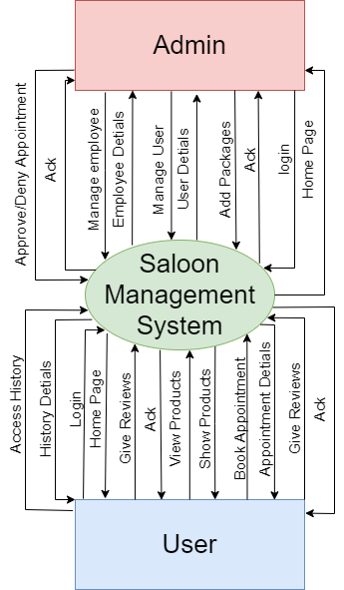
Level 0 (Context Level):

Slide 21
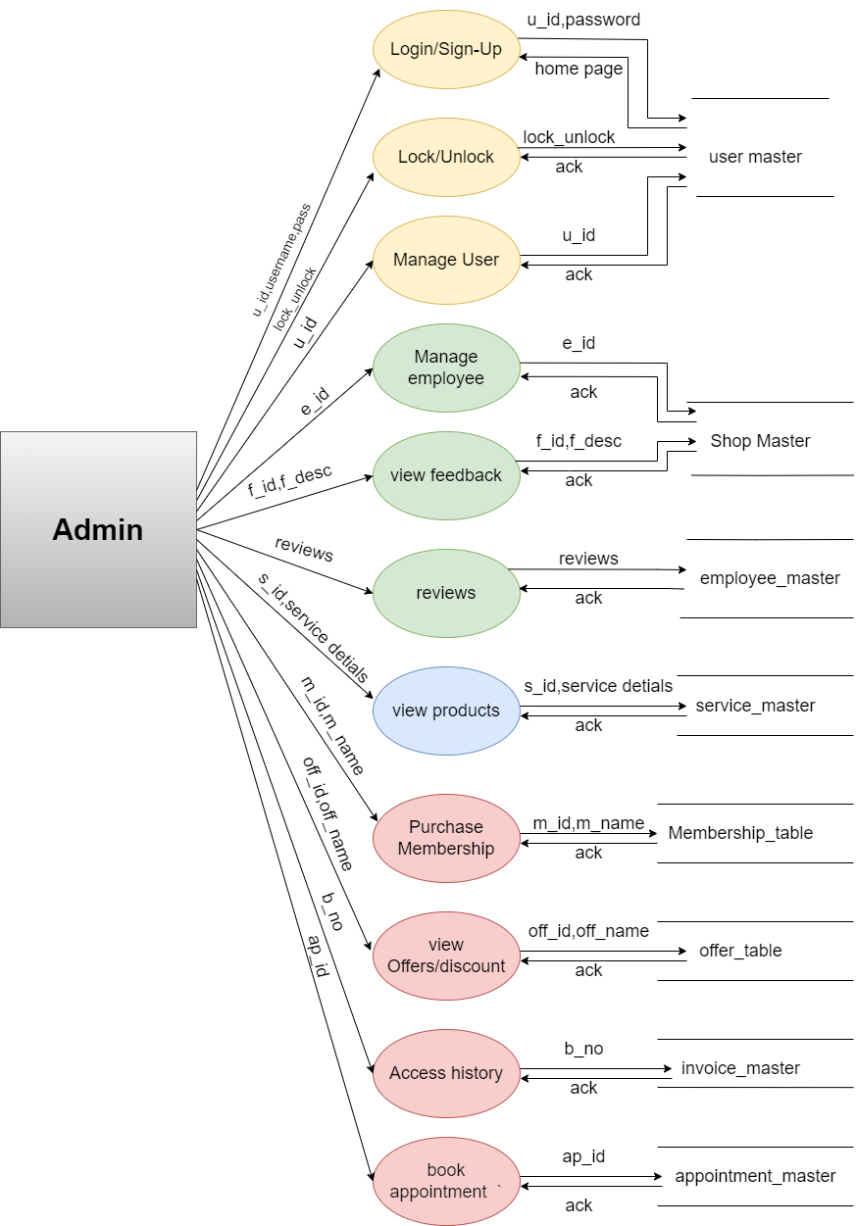
Level 1 Admin

Slide 22
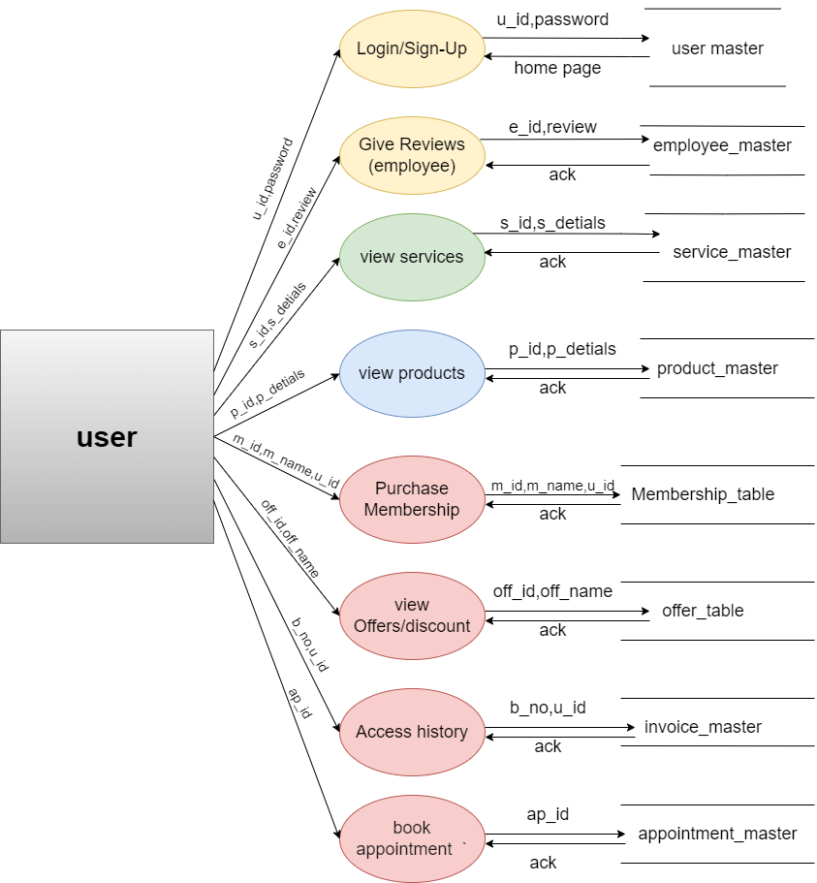
Level 1 User

Slide 23
Tools and Technology
Frontend
HTML 5,CSS 3
Backend
PHP V 8.0.22
Database
MySQL 8.0.32.

Slide 24
This system will help saloons to pitch their business underneath their space to expand their everyday business. This project also helps local vendors to show their presence globally on the internet and serve their customers with their art. In the salon and beauty industry, the Online Reservation System is suitable for use to reduce customer waiting time and experience a hassle-free environment.
Conclusion

Slide 25

Thank you
Thanks to your commitment and strong work ethic, we know next year will be even better than the last.
We look forward to working together.

